Slide 1
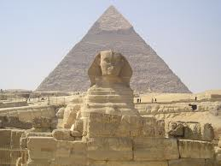
The Great Pyramid at Giza is believed to have been constructed for an Egyptian pharaoh over a ten to twenty year period around 2650 BC. It was 451 feet tall when it was built, and was the tallest man-made structure on Earth for more than 3,500 years.

Slide 2
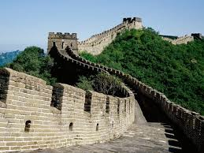
The Great Wall of China was built as a series of defensive walls to protect China’s northern border. The most famous portion of the wall was built around 200 BC.

Slide 3
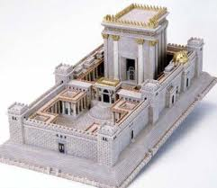
This is a reproduction of the second temple in Jerusalem (the first was built in about 1,000 BC and destroyed a few hundred years later). In 538 BC, construction on this temple began. It was destroyed around 70 AD.

