Slide 1
Ch 1. Notes Psychology (continued)

Slide 2
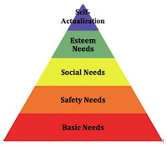
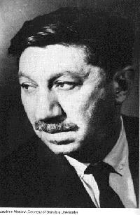
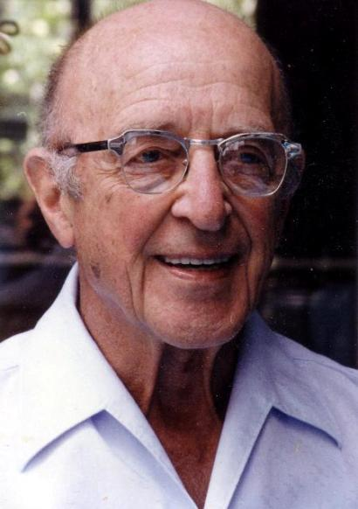
Maslow’s
Hierarchy
of Needs
Maslow and Rogers emphasized current environmental influences on our growth potential and our needs for love and acceptance.
Must be nurtured to achieve our full potential
13

Slide 3
Putting the Psyche (mind) Back in Psychology:
The Return of Cognition
Cognitive psychology is the most popular school of psychology today.
Focus on our thinking patterns -- how we process information and the ‘schemas’ we form (Piaget).
If you break up with your significant other and go into a great depression, the cognitive therapist would say that you have learned somewhere before that you should act depressed when you end a relationship ➔ you have a schema for a breakup.
They would focus on changing your schema to get you out of the funk.
  They might say things like "there are other fish in the sea" or "you will find somebody better".
  If they can change the way you view a situation (your schema) then they help you function more efficiently in society.
If you think about it, we are all cognitive therapists. We all give advice to our friends by trying to change their perspective of a dire situation.
14

Slide 4
Putting the Psyche (mind) Back in Psychology:
The Return of Cognition
Cognitive School:
  Concentrate on thinking, knowing, remembering
  1950’s and 60’s– Piaget (children’s cognition) Chomsky (language), and Simon (Artificial intelligence, problem solving/cognition)
  How and why do you know what you know
  Jean Piaget- “schemas”, a way to view the world
    encounter new and novel situations, we can “assimilate” (if its close)
    or we can “accommodate” if we need to change our existing schemas
  Some researchers argue that cognitive psychology is now the dominant perspective in psychology.
14

Slide 5
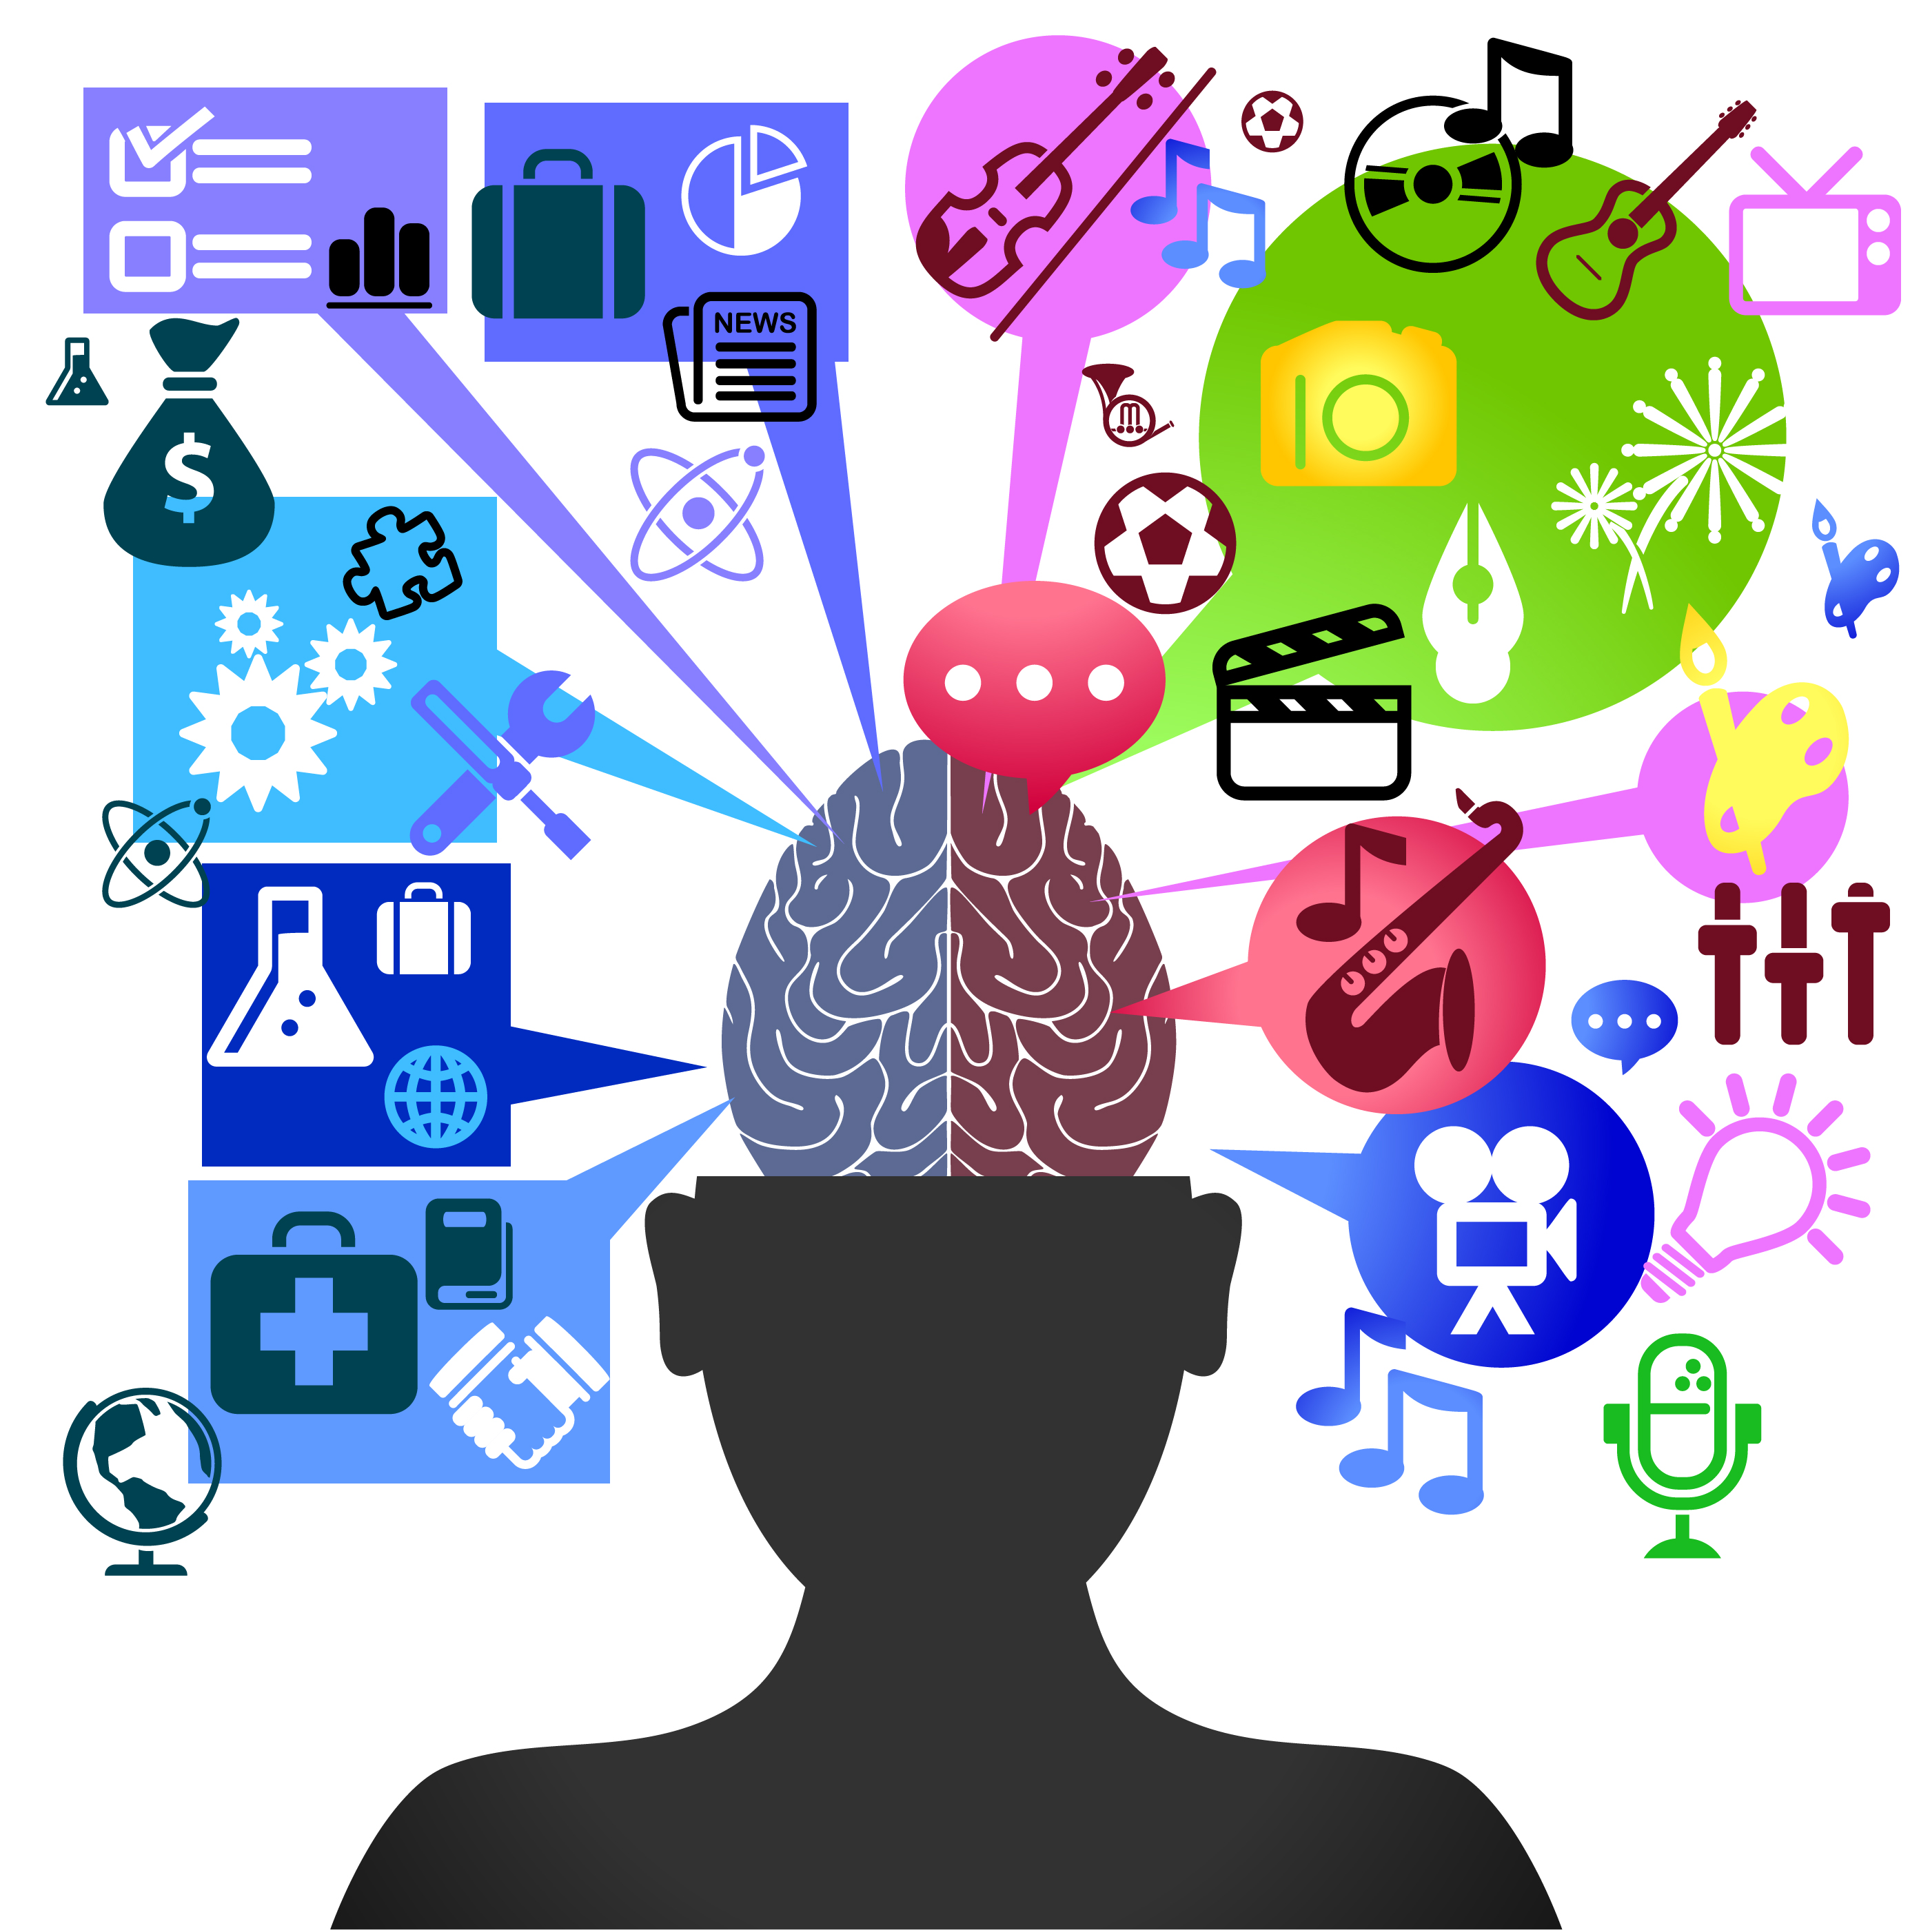
Biological Psychology:
The Biological Basis of Behavior
Biological perspective - behavior explained in terms of physiological processes
  James Olds (1956)
    Electrical stimulation of the brain evokes emotional responses in animals
  Roger Sperry (1981)
    Left and right brain hemisphere specialization: each handle different types of mental tasks.
15

Slide 6
Psychology Today
We define psychology as the scientific study of behavior (what we do) and mental processes (inner thoughts and feelings).
A much more eclectic approach to studying the human mind and behavior
Contemporary schools of thought (7 schools):
Biopsychology (organic causes, brain, biochemistry)
Evolutionary Perspective (Darwin stuff)
Psychodynamic (unconscious mind)
Behavioral (what we can see)
Humanist (free will)
Cognitive (how we think about ourselves and the world)
Social-Cultural (behavior is dictated by your culture)

Slide 7
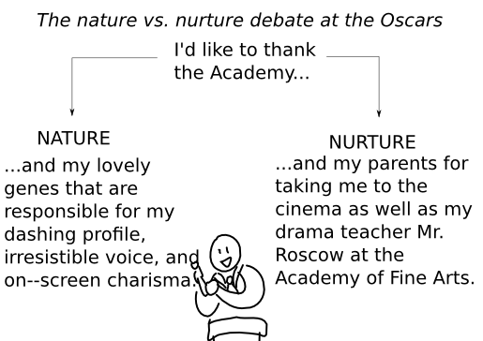
Contemporary Psychology
Psychology’s 1st Big Debate
Nature versus Nurture
How much of our thinking & behavior is due to biological influences (nature) & what role does the environment play (nurture)
Often studies involve identical (monozygotic) twins who were separated at birth. Accounts for nature variables so any differences must be from nurture
16, 17

Slide 8
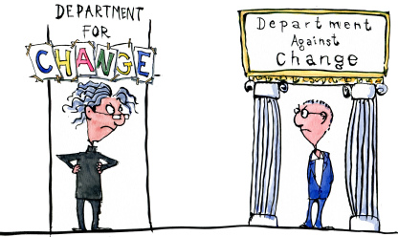
Psychology’s 2nd Big Debate
Stability versus Change
How much of who we are and how we behave will change over our lifetime?
  Baby temperament a predictor of personality?
  Likes and dislikes, ways of thinking
  Are you going to become your parents???
16, 17

Slide 9
Psychology’s 3rd Big Debate
Continuity versus Stages
Is development a continuous process or does it occur in distinct stages?
  We will study stage theorists of social (Erickson), cognitive (Piaget), and moral (Kohlberg) development
16, 17

Slide 10
Studying Psychology: 7 Organizing Themes
Psychology as a field of study:
1. Empirical | Empiricism is the premise that knowledge should be acquired through observation… Psychologists conduct scientific research to TEST their ideas.
2. Theoretically diverse | A theory is a system of interrelated ideas used to explain a set of observations…in psychology, we have many competing theories…Freud, for example, would explain behavior in different terms than would Skinner…there is often more than one way to look at something.
3. Evolves in socio-historical context | Psychology and other sciences are influenced by trends, issues, and values in society…for example, the rapid growth of clinical psychology was greatly influenced by the war-related surge in the demand for clinical services.
18

Slide 11
Studying Psychology: 7 Organizing Themes
Behavior:
4. Determined by multiple causes | Behavior is governed by a complex network of interacting factors…why will you make an A in psychology? Intelligence, study skills, memory, motivation?
5. Shaped by cultural heritage | Culture refers to the widely shared customs, beliefs, values, norms, institutions, and other products of a community that are transmitted socially across generations…cultural factors shape behavior and influence our interpretations of behavior
6. Influenced jointly by heredity and environment | Heredity and environment interact to mold behavior in complex ways…it’s not nature or nurture, but the impact of nurture on nature and nature on nurture.
7. People’s experience of the world is highly subjective. | Motives and expectations influence people’s experiences…the scientific method is used to keep this from being a problem.
19

Slide 12
Psychology’s Three Main Level of Analysis
Biological influences
genetic predispositions
genetic mutations
natural selection of adaptive physiology and behaviors
genes responding to environment
Psychological Influences
learned fears and other learnt expectations
emotional responses
cognitive processing and perceptual interpretations
Behavior or mental process
Social-cultural Influences
presence of others
cultural, societal, and family expectations
peer and other group influences
compelling models (such as media)

