Slide 2
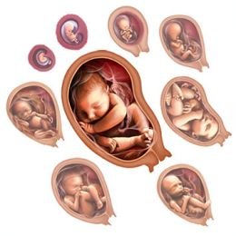
Prenatal Development and the Newborn
How, over time, did we come to be who we are? From zygote to birth, development progresses in an orderly, though fragile, sequence.

Slide 3
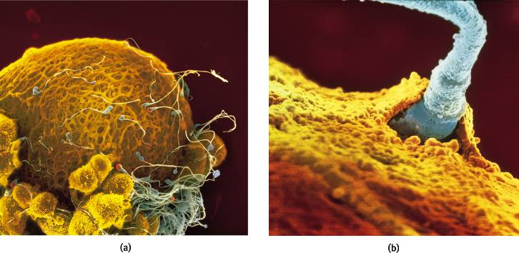
Conception
A single sperm cell (male) penetrates the outer coating of the egg (female) and fuse to form one fertilized cell.
Lennart Nilsson/ Albert Bonniers Publishing Company
Lennart Nilsson/ Albert Bonniers Publishing Company
Notes:
OBJECTIVE 8-2| Describe the union of sperm and egg at conception.

Slide 4
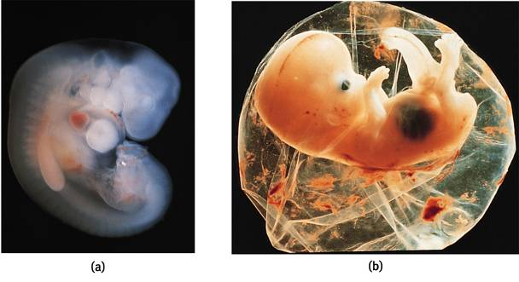
Prenatal Development
A zygote is a fertilized cell with 100 cells, which become increasingly diverse. At about 14 days the zygote turns into an embryo (a and b).
Lennart Nilsson/ Albert Bonniers Publishing Company
Biophoto Associates/ Photo Researchers, Inc.
Notes:
OBJECTIVE 8-3| Define zygote, embryo and fetus, and explain how teratogens can affect development.

Slide 5
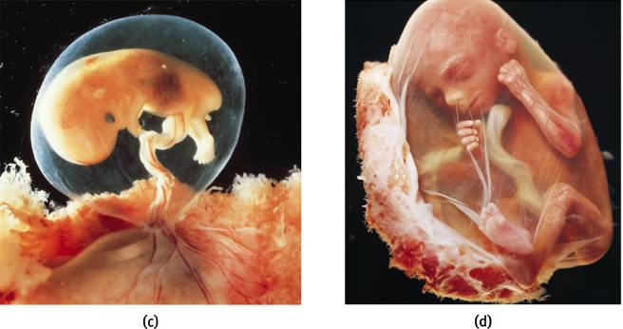
Prenatal Development
At 9 weeks an embryo turns into a fetus (c and d). Teratogens are chemicals or viruses that can enter the placenta and harm the developing fetus.
Lennart Nilsson/ Albert Bonniers Publishing Company
Lennart Nilsson/ Albert Bonniers Publishing Company
1

Slide 6
Teratogens
Substances that cross the placental barrier and prevent the fetus from developing normally
Includes: radiation, toxic chemicals, viruses, drugs, alcohol, nicotine, etc.
Example: Fetal alcohol syndrome
Prenatal health care begins early in pregnancy, with a focus on guidance from health professionals.
Prenatal care is associated with higher survival rates and reduced prematurity
But many women, because of poverty and other problems, do not receive prenatal care
1, 2
Notes:
Maternal illness can also interfere with prenatal development; the nature of the damage depends, in part, on when the mother contracts the illness (this is graphically depicted on the next slide).
Prenatal health care begins early in pregnancy, with a focus on guidance from health professionals. Prenatal care is associated with higher survival rates and reduced prematurity, but many women, because of poverty and other problems, do not receive prenatal care.

Slide 7
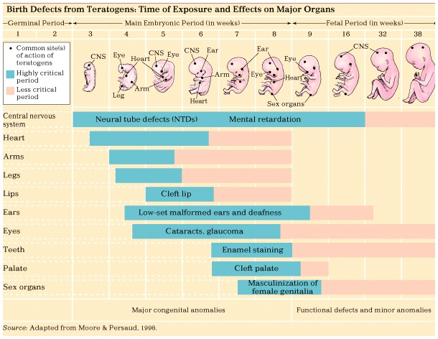
Notes:
A developing baby and its mother are linked through the placenta, and a mother’s behaviors can affect the baby dramatically.
Severe maternal malnutrition is linked to increased risk of birth complications and neurological problems in the newborn. Moderate maternal malnutrition has been shown to have negative effects for many years after birth. Research links maternal malnutrition to vulnerability, schizophrenia, and other psychiatric disorders in adolescence and early adulthood.
Maternal drug use can significantly impact a developing baby, even if the drugs are legal, like alcohol and cigarettes. Many drugs, both prescription and recreational, are linked to birth defects. Problems can even be caused by some over the counter drugs.
Fetal alcohol syndrome, one of the leading causes of mental retardation, is a collection of congenital (inborn) problems associated with excessive alcohol use during pregnancy. Problems include microcephaly, heart defects, irritability, hyperactivity, and delayed mental and motor development. FAS is also related to increased incidence of depression, suicide, and criminal behavior in adulthood. Many children don’t meet the criteria for a diagnosis of FAS but are still impaired due to their mother’s drinking. While degree of impairment has been shown to be related to the amount of alcohol consumed by a pregnant woman, current studies suggest that even normal social drinking can have enduring negative effects on children, including deficits in IQ, reaction time, motor skills, attention span, and math skills, as well as impulsive, antisocial, and delinquent behavior.

Slide 8
Infancy and Childhood
Infancy and childhood span from birth to teenage years. During these years the individual grows physically, cognitively and socially.
Stage | Span
Infancy | Newborn to toddler
Childhood | Toddler to teenager

Slide 9
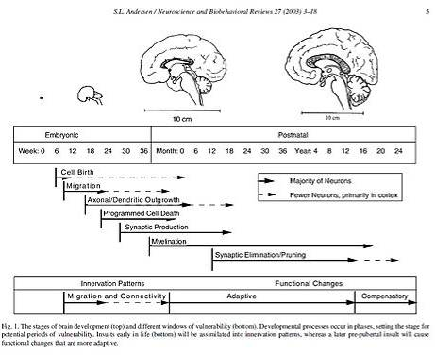
Physical Development
Infants’ psychological development depend on their biological development.
To understand emergence of motor skills and memory we must understand the developing brain.
Notes:
Basic Principles
-Cephalocaudal trend – head to foot
-Proximodistal trend – center-outward
Maturation – gradual unfolding of genetic blueprint
Developmental norms – median age
-Cultural variations
Motor development refers to the progression of muscular coordination required for physical activities.
A basic number of principles are apparent in motor development. The cephalocaudal trend describes the fact that children tend to gain control over the upper part of their bodies before the lower part.
The proximodistal trend describes the fact that children gain control over their torsos before their extremities.
Motor development depends in part on physical growth, as well as on the process of maturation (the gradual unfolding of one’s genetic blueprint), and the infant’s ongoing exploration of the world.
Developmental norms indicate the median age at which individuals display various behaviors and abilities…useful benchmarks only.
Cultural variations in motor development indicate the importance of experience on the development of motor skills. Nevertheless, the similarities across cultures outweigh the differences, illustrating the importance of maturation.

Slide 10
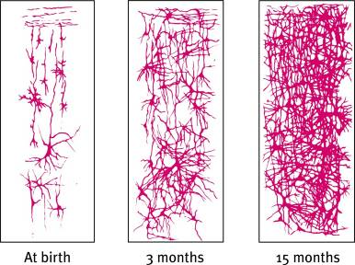
Developing Brain
The developing brain overproduces neurons. Peaking around 28 billion at month 7 of pregnancy
These neurons are pruned (reduced) to 23 billion at birth.
The greatest neuronal spurt is in the frontal lobe enabling the individual for rational thought.
Notes:
OBJECTIVE 9-1| Describe some developmental changes in the child’s brain, and explain why maturation accounts for many of our similarities.

Slide 11
Maturation
The development of the brain unfolds based on genetic instructions, leading various bodily and mental functions to occur in sequence— standing before walking, babbling before talking—this is called maturation.
➔Maturation sets the basic course of development
➔Experience adjusts that development
3

Slide 12
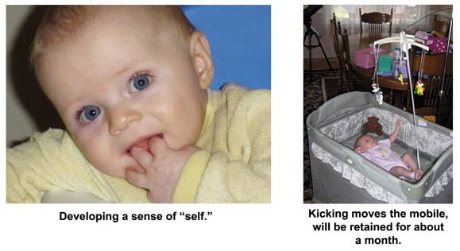
Maturation and Infant Memory
Earliest age of conscious memory is around 3½ years (Bauer, 2002). A 5-year-old has a sense of self and an increased long-term memory, thus organization of memory is different from 3-4 years.
Courtesy of Carolyn Rovee-Collier
Amy Pedersen
5
Notes:
OBJECTIVE 9-3| Explain why we have few memories of experiences during our first three years of life.

Slide 13
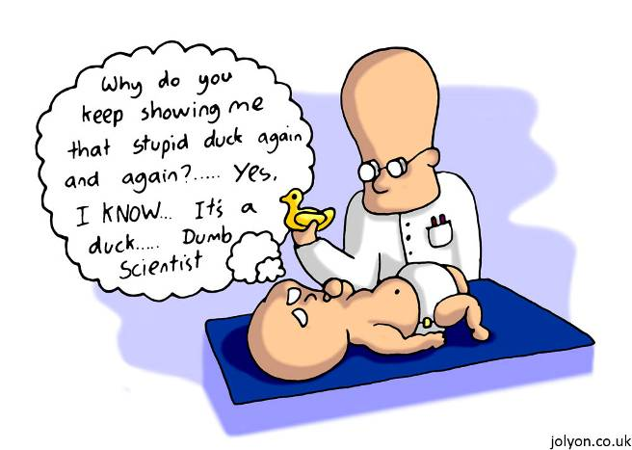
Cognitive Development in the Newborn
Investigators study infants getting habituated to objects over some duration of time. New objects are paid more attention than habituated ones, showing learning.
7

