Slide 1
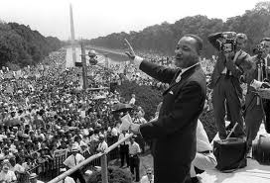
August 1963- March on Washington
200,000 people march to Lincoln Memorial. This is where King gives his “I Have a Dream Speech.” Listen to an excerpt here: http://www.youtube.com/watch?v=V57lotnKGF8&safety_mode=true&persist_safety_mode=1&safe=active

Slide 2
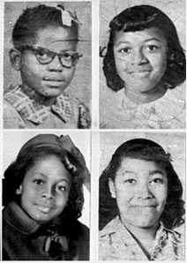
Sept. 1963--16th St. Baptist Church Bombed
A bomb goes off during Sunday School at the 16th St. Baptist Church in Birmingham (where the Children’s March was launched). It kills 4 little girls.

Slide 3
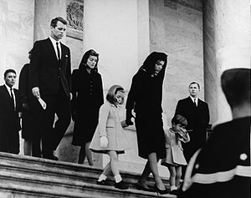
Nov. 22, 1963—JFK assassinated.
Lee Harvey Oswald assassinates President Kennedy during a parade in Dallas. View the footage here: http://www.youtube.com/watch?v=qwmaTT8oWec&safety_mode=true&persist_safety_mode=1&safe=active

Slide 4
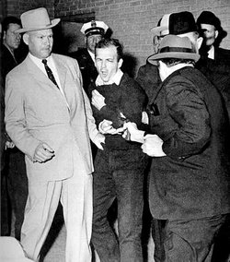
(You don’t have to write this slide down)
Two days later, nightclub owner Jack Ruby kills Lee Harvey Oswald, leaving Oswald’s motive unknown and sparking many conspiracy theories.

Slide 5
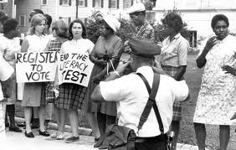
Summer 1964--Freedom Summer
A massive effort to register African-American voters takes place in Mississippi. Many volunteers from CORE and SNCC (new Civil Rights groups) come. 3 are murdered. Watch this clip from Mississippi Burning to learn about it: http://www.youtube.com/watch?v=IyO9gjUfUSs&safety_mode=true&persist_safety_mode=1&safe=active

Slide 6
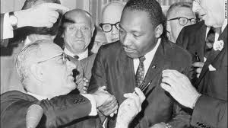
June 1964
President Lyndon B. Johnson (LBJ) signs the Civil Rights Act of 1964. It prohibits discrimination based on race.

Slide 7
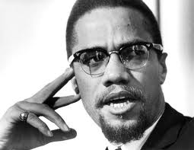
Feb. 1965 Malcolm X is assassinated
After leaving the radical civil rights group Nation of Islam (led by Elijah Muhammad) to return to more mainstream Islamic faith, Malcolm X is assassinated by a member of the Nation of Islam.

Slide 8
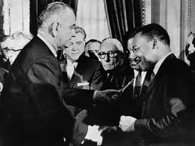
August 1965—Voting Rights Act of 1965 passed
Makes it easier for Southern African-Americans to vote by outlawing literacy tests and poll taxes. Signed by LBJ.

Slide 9
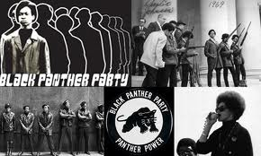
1965-1966
Race riots erupt in Watts, Los Angeles and Detroit. Watch one here: http://www.youtube.com/watch?v=w0lyYj2MPg8&safety_mode=true&persist_safety_mode=1&safe=active
Stokley Carmichael, leader of SNCC, coins the term “Black Power”
Bobby Seale and Huey Newton found the Black Panther Party.

Slide 10
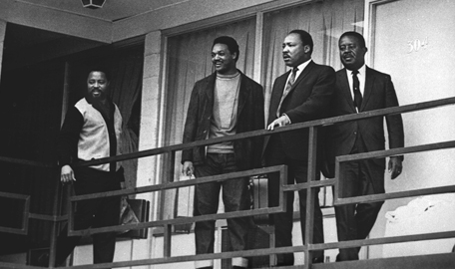
April 4, 1968-Assassination of MLK, Jr.
MLK, Jr. is assassinated on the balcony of his hotel in Memphis by James Earl Ray.

Slide 11
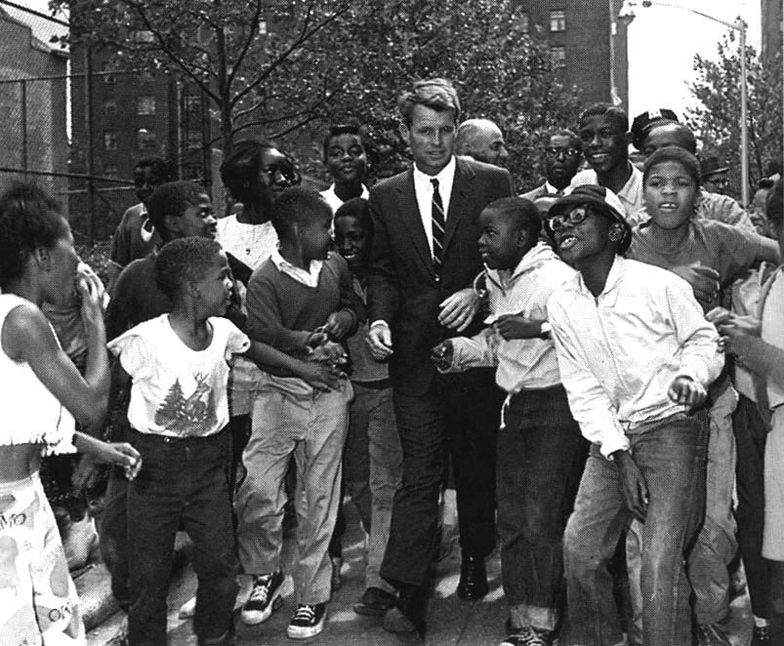
June 1968
Robert F. Kennedy (nicknamed Bobby Kennedy), JFK’s younger brother and former Attorney General of the US, is assassinated. He was running for president. Bobby Kennedy was known for his support of Civil Rights.

