Slide 1
The Russian Revolution and its aftermath

Slide 2
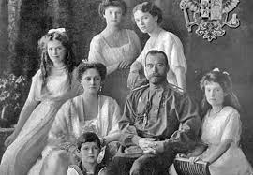
Tsar Nicholas II and his family
Unlike most of Europe, Russia was ruled by an absolute monarch until 1905. After some uprisings, Tsar Nicholas II granted some power to a legislature, but remained very powerful. He believed that he had a “divine right” to rule, even though he wasn’t a very effective ruler.
Tsar Nicholas needed a son to inherit his throne, but he had five daughters in a row. His sixth child was a boy, but there was a problem. Tsarina Alexandra was the granddaughter of Queen Victoria of England, and was a carrier of hemophilia, a disease that plagued Victoria’s descendants. Their son, Alexei, was a hemophiliac. He bled profusely even from a small cut and was likely to die from a minor injury.

Slide 3
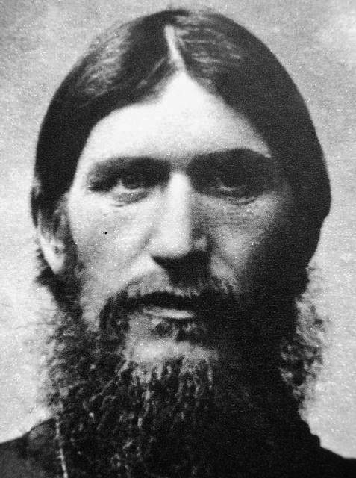
Rasputin
Rasputin was a peasant and a “holy man” that befriended the tsar and his family. Desperate to cure their son’s hemophilia, the tsar and tsarina turned to him for his supposed mystic healing abilities. Over time, he became very influential with the royal family, especially the tsarina. Many people began to worry that he exerted too much control in Russia. This only got worse when Nicholas went to join the army at the front in WWI. This became increasingly unpopular, especially among the upper class due to Rasputin’s low-birth status. In 1916, a group of nobles claiming to act in the interest of “saving the monarchy” murdered Rasputin.

Slide 4
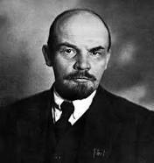
Vladimir Lenin
Lenin, a communist, becomes the leader of the Bolshevik Revolution. Prior to WWI, he had been exiled for his radical politics, and was living in Switzerland at the beginning of the Russian Revolution.

Slide 5
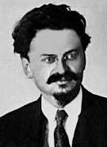
Leon Trotsky
Trotsky is another Communist leader and was the one of the two likely successors of Lenin. He was known for being an intellectual, and he was very popular.

Slide 6
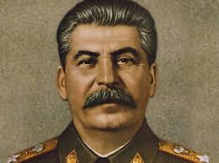
Joseph Stalin
Joseph Stalin comes to power after the death of Lenin, after eliminating Trotsky, a rival for his power. He was ruthless, calculating and very paranoid. He rules until his death in 1953. Historians estimate that Stalin was responsible for 30 million deaths in Russia, mainly of political opponents. Some of these deaths were also a result of a famine (which he engineered on purpose in some areas).

Slide 7
World War I was disastrous for Russia. They suffered high casualty rates on the battlefield and economic hardship on the home front. The Russian government started to ration bread, leaving women without enough to feed their children. In March 1917, working-class women held strikes in Petrograd (St. Petersburg) demanding “Peace and Bread.” Other workers joined them and a general strike shut down all the factories in Petrograd.

Slide 8
Many soldiers in Petrograd refused to shoot at the crowd. Instead, they joined the demonstrators. No longer supported by the army, the tsar resigned. A provisional government was put in place, but Russia stayed in the war.

Slide 9
The Bolsheviks began as a small group that supported the ideas of Marx. Their leader was Lenin. He had been in exile prior to the revolution. German leaders, at war with Russia and hoping to cause problems inside the country, shipped him back in April 1917.
Lenin believed that only violent revolution could end the capitalist system. The Bolsheviks promised to end the war, redistribute land, and put committees of workers in charge of factories. He also believed that because Russia was still a largely agricultural country, that the workers weren’t completely ready to rule themselves yet. Instead, he said a group of revolutionaries who understood communism would rule until the workers were ready.

Slide 10
On November 6, the Bolsheviks took control and the provisional government collapsed. Although the government claimed to give power to workers’ groups, Lenin held all real power. He pulled Russia out of WWI, but civil war quickly broke out in Russia between the Communists (Reds) and their opponents (Whites). Their opponents were a mix of people who supported the tsar, liberals who wanted a constitutional monarchy, and moderate socialists who wanted gradual reform and democracy. The Allies (of WWI) sent aid to the anti-communist forces. By 1921, the Communists were in total command of Russia. It was a centralized, one-party state.

