Slide 1
Prenatal Development and the Newborn
Prenatal development milestones
Teratogens
Notes:
Prenatal development begins with the germinal stage, lasting from conception to about 2 weeks. During this stage, rapid cell division occurs, and the mass of cells migrates to the uterus and beings to implant into the uterine wall, forming a placenta during the implantation process.
The placenta is a structure that allows oxygen and nutrients to pass into the fetus from the mother’s bloodstream and bodily wastes to pass out to the mother.
The embryonic stage lasts from 2 weeks to 2 months and is the period when most of the vital organs and bodily systems such as the heart, spine, and brain emerge. The embryonic period is a time of great vulnerability; if anything interferes with development during this time period, effects can be devastating.
The fetal period lasts from 2 months to birth. During the early parts of this stage, the muscles and bones begin to form. The body continues to grow and function, with sex organs developing in the 3rd month and brain cells multiplying during the final 3 months.
Somewhere between 22 and 26 weeks, the age of viability is reached…when the baby could survive if born prematurely. At 22 or 23 weeks, chances for survival are slim, but by 26-28 weeks chances improve to a survival rate of about 85%.

Slide 2
Developmental Psychology
Issue | Details
Nature/Nurture | How do genetic inheritance (our nature) and experience (the nurture we receive) influence our behavior?
Continuity/Stages | Is development a gradual, continuous process or a sequence of separate stages?
Stability/Change | Do our early personality traits persist through life, or do we become different persons as we age.
Notes:
OBJECTIVE 8-1| State the three areas of change that developmental psychologists study, and identify the three major issues in developmental psychology.

Slide 3
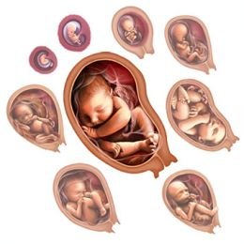
Prenatal Development and the Newborn
How, over time, did we come to be who we are? From zygote to birth, development progresses in an orderly, though fragile, sequence.

Slide 4
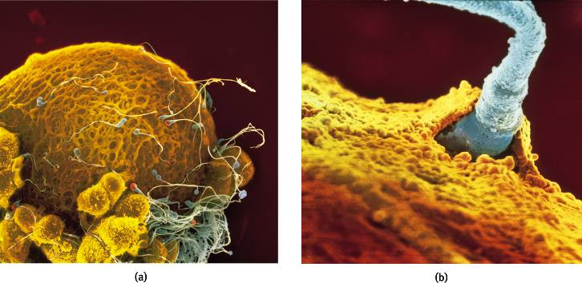
Conception
A single sperm cell (male) penetrates the outer coating of the egg (female) and fuse to form one fertilized cell.
Lennart Nilsson/ Albert Bonniers Publishing Company
Lennart Nilsson/ Albert Bonniers Publishing Company
Notes:
OBJECTIVE 8-2| Describe the union of sperm and egg at conception.

Slide 5
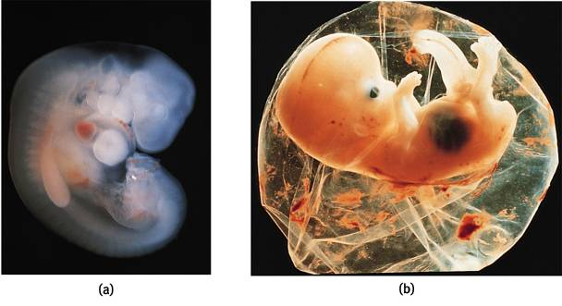
Prenatal Development
A zygote is a fertilized cell with 100 cells, which become increasingly diverse. At about 14 days the zygote turns into an embryo (a and b).
Lennart Nilsson/ Albert Bonniers Publishing Company
Biophoto Associates/ Photo Researchers, Inc.
Notes:
OBJECTIVE 8-3| Define zygote, embryo and fetus, and explain how teratogens can affect development.

Slide 6
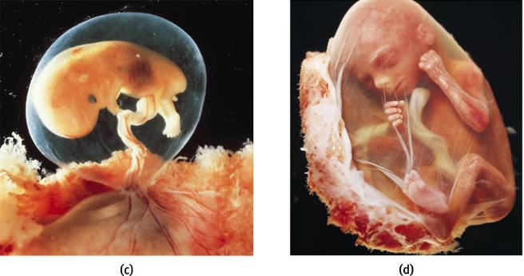
Prenatal Development
At 9 weeks an embryo turns into a fetus (c and d). Teratogens are chemicals or viruses that can enter the placenta and harm the developing fetus.
Lennart Nilsson/ Albert Bonniers Publishing Company
Lennart Nilsson/ Albert Bonniers Publishing Company
1

Slide 7
Teratogens
Substances that cross the placental barrier and prevent the fetus from developing normally
Includes: radiation, toxic chemicals, viruses, drugs, alcohol, nicotine, etc.
Example: Fetal alcohol syndrome
Prenatal health care begins early in pregnancy, with a focus on guidance from health professionals.
Prenatal care is associated with higher survival rates and reduced prematurity
But many women, because of poverty and other problems, do not receive prenatal care
1, 2
Notes:
Maternal illness can also interfere with prenatal development; the nature of the damage depends, in part, on when the mother contracts the illness (this is graphically depicted on the next slide).
Prenatal health care begins early in pregnancy, with a focus on guidance from health professionals. Prenatal care is associated with higher survival rates and reduced prematurity, but many women, because of poverty and other problems, do not receive prenatal care.

Slide 8
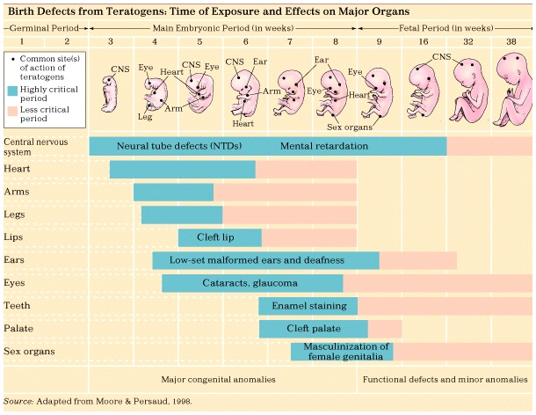
Notes:
A developing baby and its mother are linked through the placenta, and a mother’s behaviors can affect the baby dramatically.
Severe maternal malnutrition is linked to increased risk of birth complications and neurological problems in the newborn. Moderate maternal malnutrition has been shown to have negative effects for many years after birth. Research links maternal malnutrition to vulnerability, schizophrenia, and other psychiatric disorders in adolescence and early adulthood.
Maternal drug use can significantly impact a developing baby, even if the drugs are legal, like alcohol and cigarettes. Many drugs, both prescription and recreational, are linked to birth defects. Problems can even be caused by some over the counter drugs.
Fetal alcohol syndrome, one of the leading causes of mental retardation, is a collection of congenital (inborn) problems associated with excessive alcohol use during pregnancy. Problems include microcephaly, heart defects, irritability, hyperactivity, and delayed mental and motor development. FAS is also related to increased incidence of depression, suicide, and criminal behavior in adulthood. Many children don’t meet the criteria for a diagnosis of FAS but are still impaired due to their mother’s drinking. While degree of impairment has been shown to be related to the amount of alcohol consumed by a pregnant woman, current studies suggest that even normal social drinking can have enduring negative effects on children, including deficits in IQ, reaction time, motor skills, attention span, and math skills, as well as impulsive, antisocial, and delinquent behavior.

Slide 9
Infancy and Childhood
Infant development
Cognitive development theory
Attachment
Parenting styles
Psychosocial development theory

Slide 10
Infancy and Childhood
Infancy and childhood span from birth to teenage years. During these years the individual grows physically, cognitively and socially.
Stage | Span
Infancy | Newborn to toddler
Childhood | Toddler to teenager

Slide 11
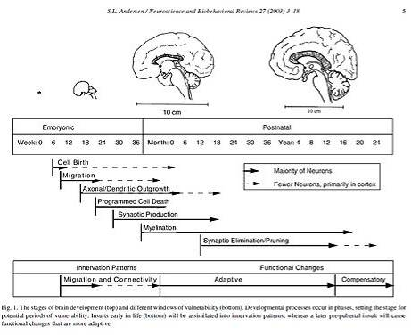
Physical Development
Infants’ psychological development depend on their biological development.
To understand emergence of motor skills and memory we must understand the developing brain.
Notes:
Basic Principles
-Cephalocaudal trend – head to foot
-Proximodistal trend – center-outward
Maturation – gradual unfolding of genetic blueprint
Developmental norms – median age
-Cultural variations
Motor development refers to the progression of muscular coordination required for physical activities.
A basic number of principles are apparent in motor development. The cephalocaudal trend describes the fact that children tend to gain control over the upper part of their bodies before the lower part.
The proximodistal trend describes the fact that children gain control over their torsos before their extremities.
Motor development depends in part on physical growth, as well as on the process of maturation (the gradual unfolding of one’s genetic blueprint), and the infant’s ongoing exploration of the world.
Developmental norms indicate the median age at which individuals display various behaviors and abilities…useful benchmarks only.
Cultural variations in motor development indicate the importance of experience on the development of motor skills. Nevertheless, the similarities across cultures outweigh the differences, illustrating the importance of maturation.

Slide 12
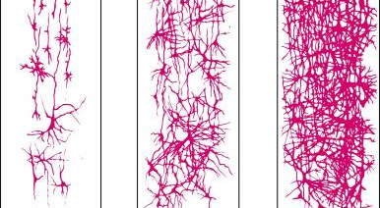
Developing Brain
The developing brain overproduces neurons. Peaking around 28 billion at month 7 of pregnancy
These neurons are pruned (reduced) to 23 billion at birth.
The greatest neuronal spurt is in the frontal lobe enabling the individual for rational thought.
Notes:
OBJECTIVE 9-1| Describe some developmental changes in the child’s brain, and explain why maturation accounts for many of our similarities.

