Slide 1
Ideologies of the Industrial Revolution
Ideology=way of understanding the world; system of beliefs

Slide 2
Laissez-faire economist
Government should keep its hands off the economy

Slide 3
Utilitarian
The right choice is whatever brings the most happiness to the most people

Slide 4
Socialist
We need a strong social safety net. The government should redistribute income to reduce income inequality.

Slide 5
Utopian
We can create a perfect society by abandoning our current systems and starting over.

Slide 6
Communist
Government should control the economy to ensure equality.

Slide 7
Social Gospel
It’s fine to be rich, but you should give back to the poor in your community.

Slide 8
Social Darwinism
“survival of the fittest” Those who are rich deserve to be rich and those who are poor deserve to be poor.

Slide 9
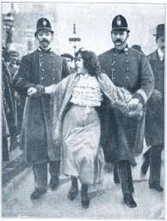
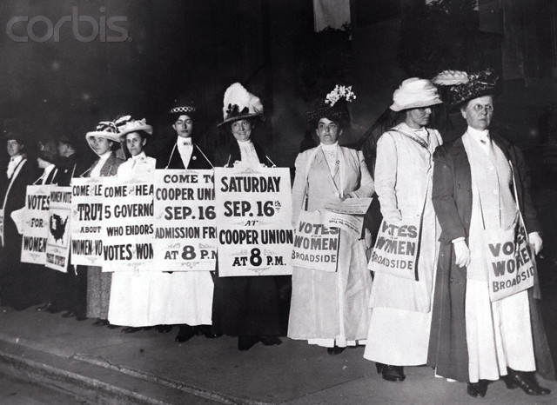
Suffragette
Women should have the right to vote (suffrage=right to vote)

