Slide 1
The industrial revolution

Slide 2
Industrial revolution
A change in the way people produce goods; a shift towards mass production of manufactured goods with machines and in factories. It starts in about 1760 in Britain.

Slide 3
Why does the IR begin in Britain?
Agricultural Revolution increases farm productivity
Enclosure movement forces peasants off land and into cities→large labor force available
New inventions like the seed drill.
Access to natural resources, especially coal and iron
stable government encourages the growth of industry
Natural waterways help with trading and power
Inventions in the textile industry: spinning jenny, flying shuttle, cotton gin

Slide 4
Later inventions of the IR
Transportation: steam engines, railroads
Communications: telegraph
Electricity
Bessemer Process: turns iron into steel

Slide 5
Problems faced by workers
Low wages
Tenement Life
Poor Working Conditions
Child Labor

Slide 6
Low Wages
Workers were paid so little that they often did not have enough to pay for rent, heat, and food. In order to get what they needed, they would go in debt to the company store, a store run by their employer. Because they owed money to the company, it made it hard to leave.
There were large differences in wages in the company. Mill manager made 192 times more than the lowest paid worker. Women made less than men.

Slide 7
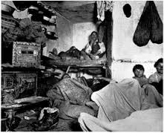
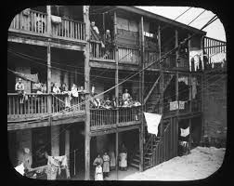
Tenement Life
Workers were crowded into tiny apartments called tenements. Tenements often lacked windows, and they were smelly and dirty. Some didn’t have bathrooms, but instead had only one outhouse for up to 150 people.

Slide 8
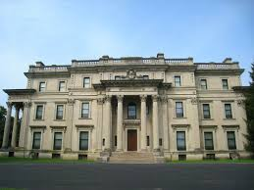
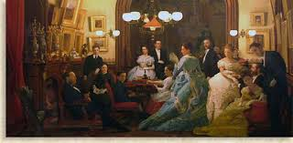
Not everyone lived in tenements. The Vanderbilt family became wealthy as a result of the Industrial Revolution (these are the Biltmore people). Their family home and a portrait of their family is shown below.

Slide 9
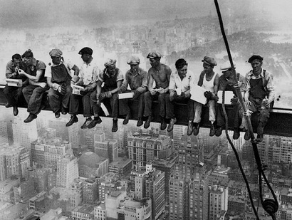
Working conditions
People often worked for up to 16 hours a day. There were no safety regulations, so many people were killed or injured at work. In New York City, the Triangle Shirtwaist Factory Fire killed 100 workers. The fabric caught fire, and there were no fire escapes. People watched from the street as people chose to jump to their death or be burned alive.

Slide 10
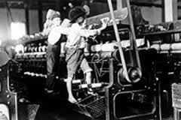
Child labor
Owners liked to hire children because they could pay them less than they paid adults and because they were small enough to reach small crevices in the machines. Children working in the textile mils began working at age 5 or 6. They worked shifts that lasted over 12 hours, and standing for that length of time left children with rickets (bowed legs), fallen arches (flat feet) and bad backs.

