Slide 1
Homework 3/24
Finishing up the Middle Ages
IMPORTANT: You will need to look through your binders to find some of this information. Treat it like a scavenger hunt; some info will be in the PowerPoint, and some you will have to go looking for!

Slide 2
Step 1: Finish Medieval Towns Notes
Instructions: Add the info in blue below to your medieval towns notes.
Effects of Medieval Towns
Development of guilds
Development of a money economy
Slow decline of feudalism
Easy to spread diseases, like the bubonic plague

Slide 3
Step 2: Finish PERSIAN chart
See following slides for instructions.

Slide 4
P: Political
We have already filled out information about feudalism. Now, add the information on wars, conflicts, and treaties. You can find this info on the Conflicts Notes. Look for conflicts that involve only political leaders. There are two (one is a war; one is a contract).
Then, look at your Crusades notes and add that conflict, too.

Slide 5
E: Economic
We have already filled out information on the manor system. Now, we need to add info from the Late Middle Ages. You need to add: guilds (plus a definition), a change to a money economy, and list 3 types of businesses you would find in a medieval town.

Slide 6
R: Religious
We have already listed some basic info about the Catholic Church. You need to add its structure (should be in your Conflict Notes) and any conflicts within the church (there should be 2—also found in your Conflict Notes—and the definition)

Slide 7
S: Social Classes
We have already added info on the 1st, 2nd, and 3rd estates. You need to add “chivalry” and how it influenced the relationships between men and women.

Slide 8
I: Intellectual—write down what’s below.
Low levels of education—clergy are the most educated and literate.
Thomas Aquinas had a philosophy called scholasticism, where he used the works of Aristotle to defend the Church’s teaching.(As part of the clergy, he was one of the few people who had access to and could read classical writings)
If science didn’t back up church teachings, it was ignored.

Slide 9
A: Arts (write this down)
Courtly love poetry about knights and ladies (connection to chivalry)
Ballads: songs that tell stories, usually not written down.
Portraits of religious figures or important events
Art was very simple and not very realistic in W. Europe
Danse macabre (connection to Black Death)
Gothic Architecture
Look through the slides that follow to make sure you understand the arts.

Slide 10
Madonna and Child (Mary and Jesus) from Italy in the 1200s
Notice how flat and 2-D
they look.
There’s no background.
That’s because they
don’t know how to
do a background in
perspective to make it
look realistic, yet!

Slide 11
Medieval artwork showing Charlemagne being crowned Holy Roman Emperor by the Pope

Slide 12
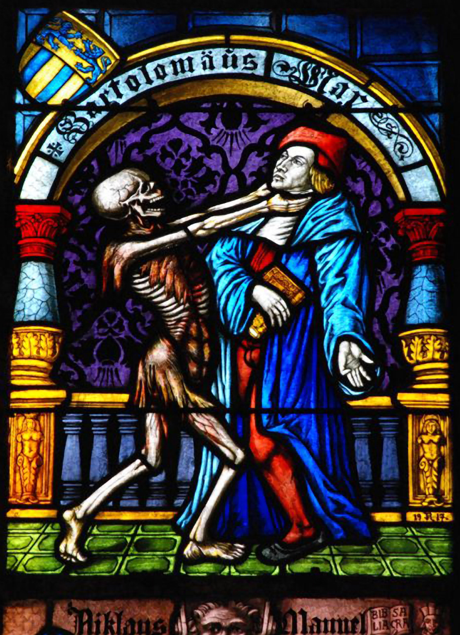
Examples of danse macabre (dance of death) artwork

Slide 13
Gothic Architecture

Slide 14
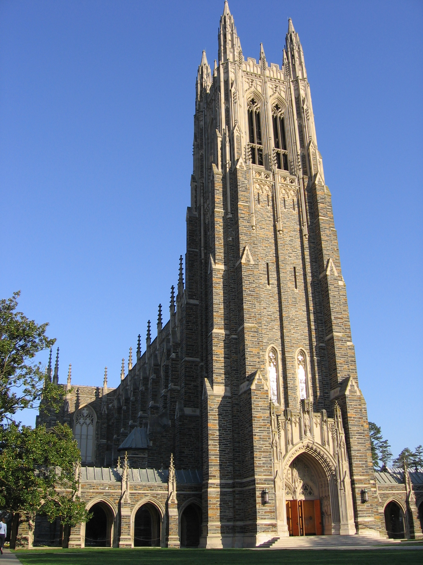
Modern day example of Gothic Architecture at Duke

Slide 15
N: Near
For this part, we already filled out “Western Europe.” We now need to add information on the environment. We should have some updated info on the environment in the Medieval Towns Notes.

