Slide 1
Regional Civilizations

Slide 2
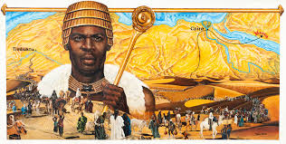
Mali (aka ghana)
The kingdom of Mali developed in West Africa as the center of the Gold-Salt trade along the Sahara desert. Its capital, Timbuktu, was known as the “City of Gold” for its enormous wealth. It thrived from about 1200 to about 1600 CE, but probably existed under the name Ghana for a few centuries before that. Its most famous leader was king named Mansa Musa. Mansa Musa converted to Islam and made the hajj to Mecca. He was so impressed with the learning in Mecca that he built a world-famous university in Timbuktu when he returned.
A modern drawing
of Mansa Musa

Slide 3
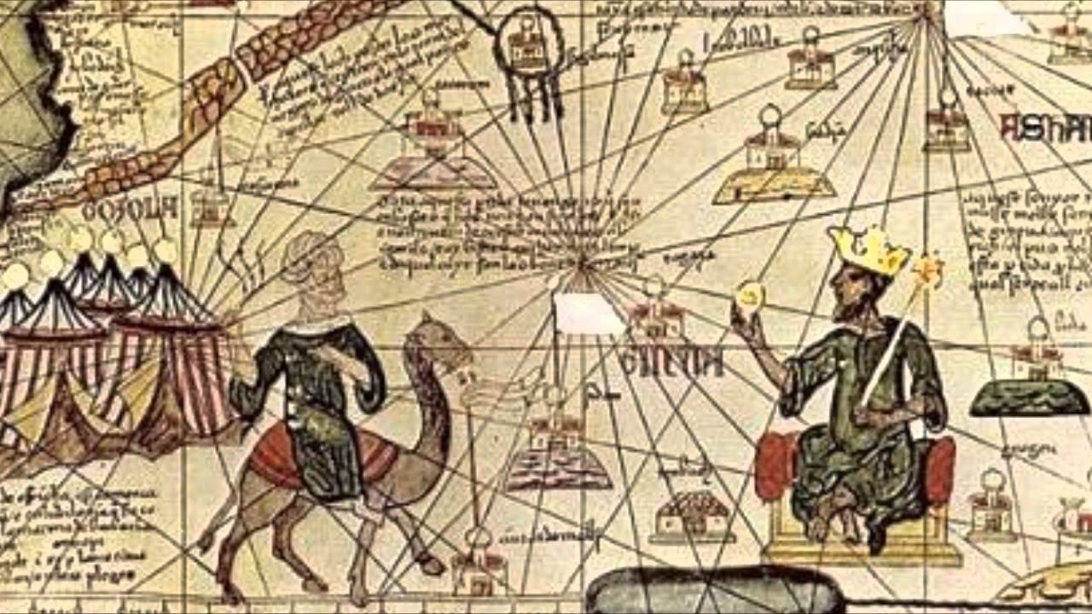
Earlier depictions of mansa musa

Slide 4
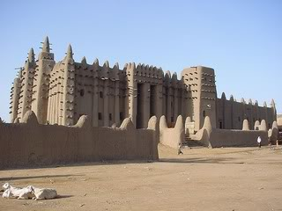
A mosque in timbuktu from the time period of the mali empire

Slide 5
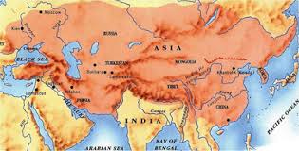
The mongol empire
The Mongol Empire began in Central Asia, but eventually became the largest empire in World History. Led by Genghis Khan, the Mongols conquered China, most of Russia, parts of Eastern Europe, and most of the Middle East. The empire lasted from 1206-1368. The Mongols were very tolerant of most religions, and almost every religion had some adherents.

Slide 6
Genghis Khan

Slide 7
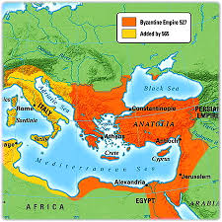
Byzantine empire
The Byzantine Empire originated from Rome. When Rome was threatened by Northern Europe tribes, it moved its capital from Rome in Italy to Constantinople (modern-day Istanbul) in what is today Turkey. When the Western half of the Roman Empire fell, the Eastern part became known as the Byzantine Empire. It lasted from about 475 AD until it fell to the Ottoman Turks in 1453.

Slide 8
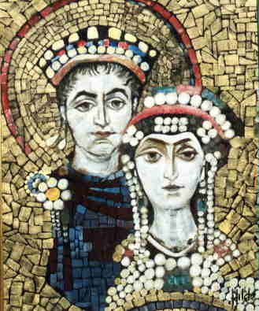
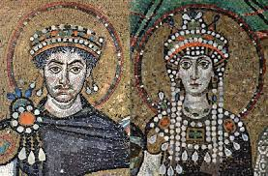
The Byzantine Empire
The most famous people from the Byzantine Empire are Justinian and his wife Theodora. Justinian is known for codifying (or writing down) the laws in “Justinian’s Code” which included the laws of the Byzantines and the Twelve Tables of Rome. The men who wrote the American Constitution used Justinian’s Code as one of the inspirations for the Bill of Rights.
depictions of
Justinian and
Theodora in
Mosaics, a
famous art
style of the
Byzantines

Slide 9
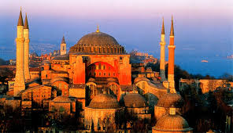
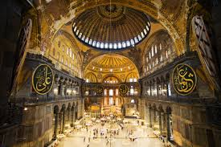
The Byzantine Empire
In about 1054, the Byzantine Empire splits from the Roman Catholic Church and practices Eastern Orthodox Christianity in what is known as the East-West Schism
The outside and inside of the Hagia Sophia, the most
famous example of Byzantine Architecture. The Hagia So Sophia was an Eastern Orthodox Church. When the
Byzantines were conquered it became an Islamic mosque. Today, it’s a museum.

Slide 10
More art from the byzantines

Slide 12
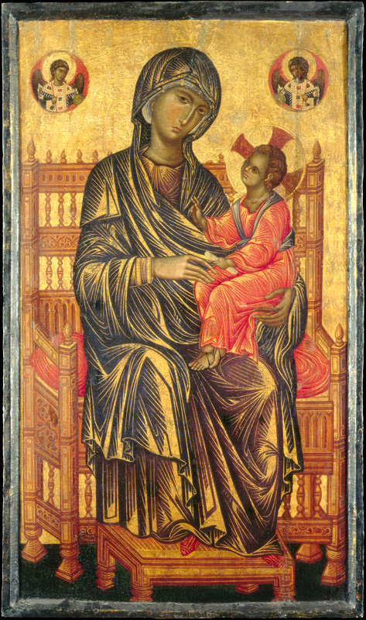
Byzantine madonna and Child (mary and jesus)

Slide 13
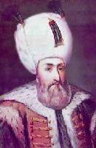
Ottoman empire
The Ottoman Empire was created by the Turks (Turkish people from the Anatolian Peninsula) in 1299. It was a Muslim Empire that constantly sought to expand, although non-Muslims living in those areas were given a protected status. In 1453, the Ottomans captured the capital of the Byzantine Empire (Constantinople), and turned it into the Ottoman capital, renaming it Istanbul. One of the most famous leaders of the Ottoman Empire was known as Suleiman the Magnificent. His empire expanded to include
Greece and other parts of Eastern Europe. During
Suleiman’s lifetime, he was considered the earthly
leader of all Muslims, nicknamed “The Lawgiver.”
Suleiman
the
Magnificent

Slide 14
Interesting facts about the ottomans
The ruler of the Ottomans were known as the Sultan. This title was inherited by the eldest son. When a new Sultan took power, he would put all his brothers in prison. When the sultan had a son to inherit the throne, he would have his brothers executed.
The sultan and his many wives lived in a large palace. The sultan would move to a different room in the palace every night because he was scared of being assassinated.
The Ottoman Empire was successful in uniting many different Islamic areas together under one ruler.
The Ottoman Empire collapsed after a period of weakness, ending with joining the Central Powers, who lost in WWI.

Slide 16
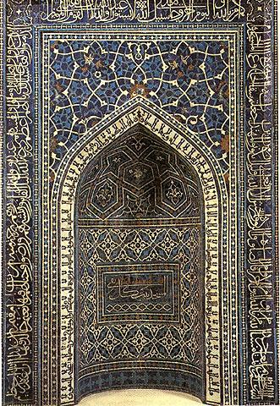
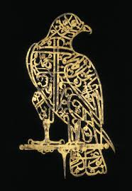
Ottoman art and architecture
Far left: domed buildings
Left: intricately designed doorway
Below: calligraphy

Slide 17
Mughal Empire
The Mughal empire was founded by a descendent of Genghis Khan named Babur from Persia (Mughal is a Persian way to say Mongol). Babur conquered Northern India, and his descendants conquered the rest of India in 1526. His grandson is the most famous ruler. His name was Akbar, and he came to be known as Akbar the Great. Akbar was Muslim, like the rest of the Mughal dynasty, but he encouraged religious tolerance. Not all the emperors were so competent. After a series of not-so-great leaders, the Mughal dynasty effectively ended in 1707 when the British became involved in India (although Mughal leaders are still around until 1857).

Slide 18
Akbar the great

Slide 19
The Taj Mahal
Built during the
Mughal dynasty.
It was paid for
by Akbar’s
grandson and
designed as a tomb
for his dead wife.

Slide 20
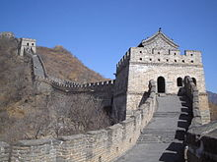
Ming dynasty
The Ming Dynasty ruled China from 1368-1644. They are known for providing political and social stability for China. The Ming rulers financed voyages overseas. Their most famous explorer was Zheng-He. The Ming dynasty is also known for the Great Wall of China. Although the wall was built much earlier, the stone and brick that you see today came from construction done during the Ming dynasty.
There were many religions during the Ming dynasty; the two that you would be most familiar with were Confucianism and Buddhism.

Slide 21
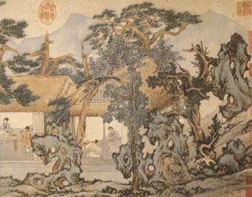
A Ming Vase
The Ming dynasty was known for its ceramics.
The Ming dynasty’s artwork
had a unique look that
was also popular in
Japan. Centuries later,
Western artists copied this
style.

Slide 22
More Ming artwork

Slide 23
Chinese mosque built during ming dynasty
(but most
Chinese
weren’t
Muslims)

