Slide 1
The Renaissance

Slide 2
The Renaissance
The Italian Renaissance was a rebirth of classical culture and learning. The word “renaissance” (with a lower-case r), literally means “rebirth” in Italian. During the Renaissance, artists and writers looked back to the culture of Rome and Greece. They viewed the Middle Ages as a dark period of time ruled by superstition instead of knowledge.

Slide 3
Renaissance Values
People from the Renaissance valued art, education, and individual achievement. Sound familiar?
An important intellectual movement of this time period was humanism. Humanism comes from valuing people and wanting them to reach their highest potential. Humanists read and studied subjects like history, poetry, and rhetoric (the humanities). Humanists didn’t deny the existence of God, but their ideas were more focused on the secular (or non-religious)

Slide 4
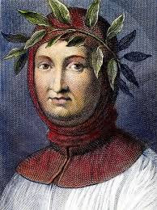
Petrarch was an Italian writer and scholar. He collected many Greek and Roman classic works that had been lost to most people during the medieval times and created a library.
Petrarch

Slide 5
Why Italy?
The Renaissance began in Italy for several reasons. First, its location made it a center for trade, and therefore wealth. Because Italy had excess wealth, it opened up opportunities for people to become artists and scholars, not just farmers. Second, the Roman Catholic Church was located in Italy. Because the Church was very wealthy, it could use that wealth to patronize (or pay for) artists to create fabulous pieces of artwork for them. Third, Italy was broken up in to separate city-states (like Venice and Milan), run by powerful families like the de Medicis,a powerful banking family and rulers of Florence. The de Medici family supported many Renaissance artists by commissioning art for the city of Florence. Finally, Rome was the location of the old center of the Roman Empire. The architectural ruins were still there, and artists and architects could draw on that history for inspiration.

Slide 6
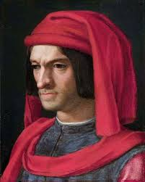
Lorenzo de Medici

Slide 7
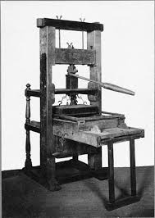
The Printing Press
Invented by Johann Gutenberg in about 1450, the printing press made it possible to copy texts quickly, instead of by hand. This helped spread the ideas of the Renaissance.

