Slide 1
Revolutions

Slide 2
Liberalism, Nationalism, and Socialism
Napoleon’s victories on the battlefields made nationalism a key ideology in the nineteenth century. People were proud of their culture, language, and history and they sought to overthrow foreign rulers who controlled them through large empires. This ideology was often intertwined with liberalism, which in this time period means the belief in constitutional governments and individual rights (think Enlightenment). Finally, the new socialist ideas of Karl Marx led many discontented workers to revolt against their current governments and seek to replace them with new governments.

Slide 3
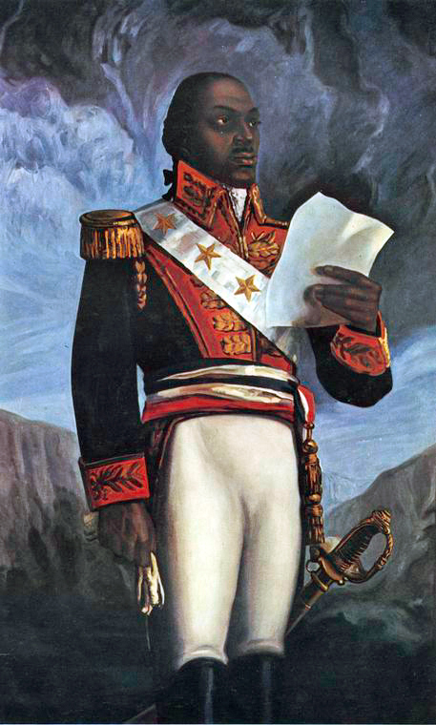
Haiti
Haiti began as the French colony of Saint Domingue. Its purpose to was produce sugar and coffee with an enslaved labor force. In 1791, while France was busy with its own revolution, a former slave named Toussaint L’Ouverture led a slave revolt. The revolt not only ended slavery on the island; it also ended French control. Haiti became the second independent republic in the Western Hemisphere (the US was the first).

Slide 4
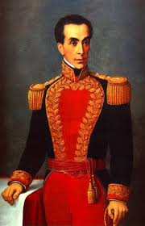
Venezuela
The struggle for Venezuelan independence began in 1810. When Napoleon conquered Spain, Napoleon became the indirect ruler of Spain’s colonies in the New World, which included Venezuela, Mexico, and many others. Venezuelan elites declared that they would rule themselves until the Spanish monarchy was restored. Simon Bolivar, a wealthy Creole (someone of European descent, but whose family had lived in the Americas for several generations), led the fight for unconditional independence from Spain. After several years of conflict, Venezuela became officially independent in 1821.
Bolivar was nicknamed “The Liberator” for all of his work
with revolutions in South America. Fun Fact: Bolivar is the
only person in World History to be exiled from a country that
was named for him (Bolivia)

Slide 5
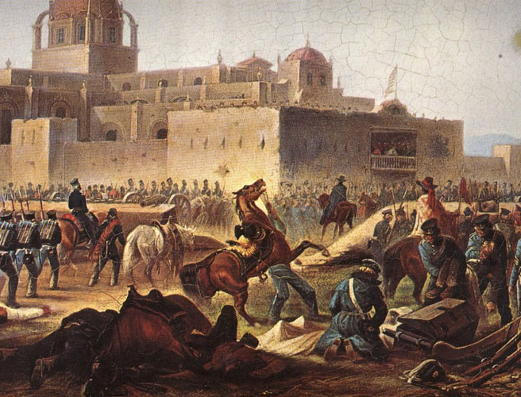
Mexico
In 1810, a revolt began in Mexico. Inspired by learning about the French Revolution, a priest named Miguel Hidalgo led an inexperienced army to attack the Spanish and attempt to free Mexico from Spanish rule. His forces were crushed, and he was sentenced to death. This revolution by the masses frightened the upper class. They helped end the revolt, but then decided to overthrow Spanish rule themselves.

Slide 6
France (1848)
By 1848, France was ruled by a constitutional monarch, Louis Phillippe. The bourgeoisie (wealthier middle class) had gained status from the French Revolution, but most common people still did not have the right to vote. Meanwhile, the Irish potato famine spread across the continent of Europe, causing hunger and unemployment. Inspired by socialist ideas, the working classes put barricades up in the streets and a Paris mob convinced Lous Phillippe into abdicating. The new government established state-owned National Workshops, but they were unsuccessful. The workers were supposed to be guaranteed work, but there was no work for them to do. This only made them more angry. After 3 days of violent class warfare, the army restored order, and Napoleon’s nephew (Louis Napoleon)became president. A few years later, Louis Napoleon took the title of Emperor and seized full control of France.

Slide 7
Austria
The Austrian Empire covered a huge portion of Central Europe. Many people living in the empire were not ethnically Austrian. These people wanted more political power for the middle-class and protections for the basic rights of male citizens. Workers wanted relief from the hardships they faced in the Industrial Revolution. The Hungarians and Czechs want to get rid of foreign rule, set up their own independent governments, and to have a written constitution to protect basic rights.
Austrian troops temporarily agreed to the demands of the Hungarians and the Czechs, then regained controlled of Vienna and Prague and defeated the rebels in Budapest. There were no lasting changes.

Slide 8
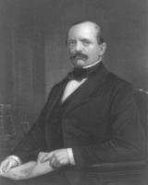
Germany
In the 1840s, many people in the German territories wanted to create a united Germany. They also wanted liberal reforms. These attempts were led by students and liberals, but they failed.
Several years later, a Prussian leader named Otto Von Bismarck decided to renew that nationalist idea of a united Germany, but he had no interest in the liberal reforms that were a part of the 1848 revolution. Through a series of military and diplomatic maneuvers, he created the modern nation of Germany under the leadership of the region of Prussia, an area known for its authoritarianism and militarism.
Bismarck was a leader who followed the ideas of realpolitik, a system of politics based on practical, not moral, considerations (think Machiavelli)

Slide 9
Italy
Italy had been divided into several parts, but many Italians wanted to be united into a single nation with democratic principles. Over a period of about 25 years, Italian leaders used careful alliances to reach their goals. In 1870, Rome became the capital of the new kingdom of Italy.

